Slide 1
Conceptual and logical DB design
Abylkassymova A.B.

Slide 2
DB Lifecycle
In order to build an effective database system it is important to understand and apply the database development lifecycle, which includes the following phases:
1. Strategy and planning
2. Requirements analysis
3. Design
4. Development
5. Deployment/implementation
6. Operations and maintenance.

Slide 3
Stages
1. Strategy and planning – typically the cycle starts with the strategy and planning phase to identify the need and scope of a new system.
2. Requirements analysis phase – a more detailed requirements analysis will be carried out which will include identifying what the users require of the system; this will involve conceptual analysis.
3. Design phase – this will involve producing a conceptual, logical and physical design. To undertake these processes it is important to be able to understand and apply the data modelling techniques. When a suitable logical design has been obtained the development phase can begin

Slide 4
Stages
4. Development phase – this involves creating the database structure using an appropriate DBMS and usually includes the development of applications that provide a user interface consisting of forms and reports which will allow controlled access to the data held in the database.
5. Deployment/implementation – when the system has been developed it will be tested, it will then be deployed ready for use.
6. Operations and maintenance – following the system release for use it will be maintained until it reaches the end of its useful life, at this stage the development lifecycle may restart

Slide 5
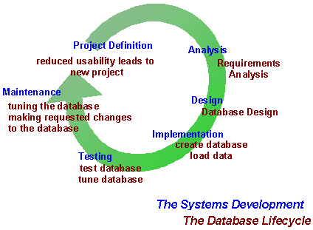
DB LIFECYCLE

Slide 6
DATABASE DESIGN
The ability to design databases and associated applications is critical to the success of the modern enterprise.
Database design requires understanding both the operational and business requirements of an organization as well as the ability to model and realize those requirements using a database.
Developing database and information systems is performed using a development lifecycle, which consists of a series of steps

Slide 7
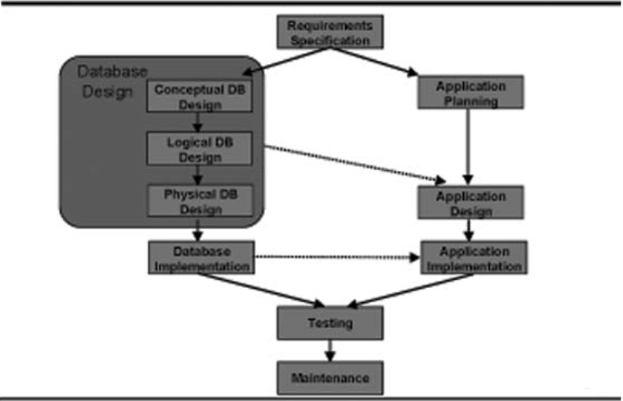
DB design Stages

Slide 8
SPECIFICATION REQUIREMENTS GATHERING
The most critical aspect of specification is the gathering and compilation of system and user requirements.
This process is normally done in conjunction with managers and users.
The major goal in requirements gathering is to:
- collect the data used by the organization,
- identify relationships in the data,
- identify future data needs,
- and determine how the data is used and generated.

Slide 9
More about requirements
These things are especially critical:
- Identification of unique fields (keys)
- Data dependencies, relationships, and constraints (high-level)
The data sizes and their growth rate
Fact-finding is using interviews and questionnaires to collect facts about systems, requirements, and preferences. Five fact-finding techniques:
• examining documentation
• interviewing
• observing the enterprise in operation
• research
• questionnaires

Slide 10
Do we really need to design stuff?
What is design?
Architects learn all the arty stuff such as where the bathrooms go and how many bathrooms there are, and whether or not there are bathrooms….
Essentially, the design process involves putting your ideas on paper before actually constructing your object, and perhaps experimenting with moving parts and pieces around a bit just to see what they look like.
In terms of the database model, you must design it before you build it and then start filling it with data and hooking it up to applications.

Slide 11
Designs
Database design involves constructing a suitable model of this information. Since the design process is complicated, especially for large databases, database design is divided into three phases:
• Conceptual database design
• Logical database design
• Physical database design

Slide 12
CONCEPTUAL DATABASE DESIGN
Conceptual database design involves modelling the collected information at a high-level of abstraction without using a particular data model or DBMS.

Slide 13
REASONS FOR CONCEPTUAL MODELING
•Independent of DBMS.
•Allows for easy communication between end-users and developers.
•Has a clear method to convert from high-level model to relational model.
•Conceptual schema is a permanent description of the database requirements.

Slide 14
ENTITY-RELATIONSHIP MODEL
- Most popular conceptual model for database design
- Basis for many other models
- Describes the data in a system and how that data is related
- Describes data as entities, attributes and relationships
The Entity Relationship Diagram (ERD) shows “entities” and the “relationships” that link them. The entities represent the data items needed by the system and the relationships show how the entities are related to one another. An “entity” is formally called an “entity type” and can be defined as:
“A group of objects with the same properties which are identified by the enterprise as having an independent existence.” (Connolly & Begg 2015, p. 406)

Slide 15
DATABASE REQUIREMENTS (First Step)
• We must convert the written database requirements into an E-R diagram
• Need to determine the entities, attributes and relationships.
– nouns = entities
– adjectives = attributes
– verbs = relationships

Slide 16
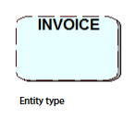
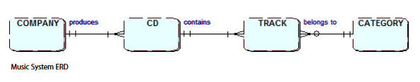
Entity
Each entity type is modeled on the ERD as a round-cornered box with the entity name inside it e.g.
You should always use UPPER case letters for entity names, and the name of the entity type should be written in the singular, e.g. INVOICE not INVOICES

Slide 17
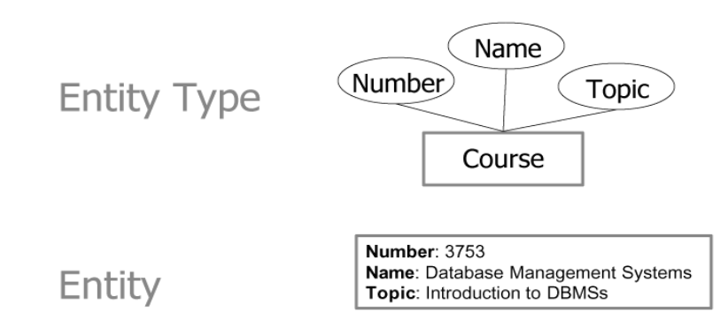
Entity types vs Entity
Entity – basic object of E-R model
Represents a “thing” with an independent existence
Can exist physically or conceptually (a professor, a student, a course)
Entity type – used to define a set of entities with the same properties.

Slide 18
Entity Occurrence
You should consider the entity type as the definition or template of what data is to be held, and an occurrence as a single set of actual data e.g. entity type: STUDENT, occurrence “Mike Jones”
For a business system: CUSTOMER, ORDER, INVOICE.
For a university system: STUDENT, LECTURER, COURSE.
Entities often fall into one of the following categories:
Physical – CAR, BUILDING
Human – CUSTOMER, EMPLOYEE
Place – FACTORY, SCHOOL
Group – DEPARTMENT, TEAM
Document – INVOICE, PAYSLIP

Slide 19

Exercise 1
Identify which of the following are likely to be entity types and which occurrences. If an occurrence, suggest a suitable entity type; if an entity type suggest a suitable occurrence:
PARIS, MODULE, AMIN KHAN, CUSTOMER, STUDENT, CITY

Slide 20
Entity attributes
A property of an entity or a relationship type;
Each entity will usually have a number of attributes.
These are the individual items of data that you need to hold for each occurrence of an entity type.
In some situations a relationship between a pair of entities may also yield attributes; this situation will be discussed later.

Slide 21
Attributes: Notations
Student ID
Student
Student
Student Name
studentID
Birth date
Student ID
name
phone
enrollment
Course no.
Birth date
Student(Student ID, Student Name, Birth Date)
Finding Attributes:
Attributes are identified progressively during BAA phase.
Data Analysis
Activity Analysis
Interaction Analysis
Current Systems Analysis

Slide 22
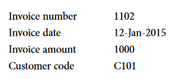
Example: Entity, Attributes, Occurance
The entity type INVOICE may include the following attributes: Invoice number, Invoice date, Invoice amount and Customer code.
An example entity occurrence of the entity type INVOICE would be as follows:

Slide 23

Exercise 2
Which of the following are likely to be attributes and which are likely to be entity types?
CUSTOMER, PRODUCT, ORDER, ORDER DATE, SIZE, QUANTITY, NAME

Slide 24
Exercise 3
What would be the identifying attribute in each of the following examples of entity types where some attributes have been identified?
CUSTOMER – Customer name, Address, Postcode, Customer code, Phone number.
INVOICE –. Invoice Date, Invoice number, Invoice Amount, Customer code.
Remember, wherever possible you should use an existing attribute for the entity identifier and make sure that it will always uniquely identify an occurrence of an entity type.

Slide 25
Entity definitions
It is important to ensure that anyone involved with designing the system is clear about the meaning of the entities being modelled.
This is achieved by clearly documenting each entity type with a concise unambiguous definition. The list of definitions is referred to as the “data dictionary” or “data repository” and is usually stored within a tool as this provides a central reference point and allows for easy searching, amendment and reporting.
Other information relating to the entities and their attributes may also be added to the data dictionary such as the number of likely entity occurrences and the data types and sizes of the attributes. This information may be needed in the design phase.

Slide 26
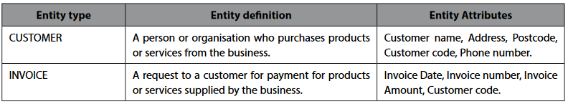
Example of Entity Definition

Slide 27
Entity Relationships
Relationships represent interactions between two or more entities
In order to see what is meant by a relationship, consider the following example which uses the music system entity types COMPANY, CD, TRACK and CATEGORY.
There are a number of relationships between these entity types as follows:
-A COMPANY produces CDs
-A CD contains music TRACKs
-A TRACK belongs to a music CATEGORY
It is important to understand how one occurrence of an entity relates to an occurrence of another entity in order to
define the relationship between them accurately

Slide 28
Exercise 4
Which of the following are relationships between entity types and which are relationships between occurrences?
1. CUSTOMER receives INVOICE
2. YORKSHIRE SUPPLIES sells TV
3. STUDENT studies COURSE
4. JOHN JACKSON studies COMPUTING
1 and 3 are relationships between entity types, 2 and 4 are relationships between entity occurrences

Slide 29
Relationship cardinality
There are three types of relationship cardinality:
One to One abbreviated as 1:1
DEPARTMENT has MANAGER
Each DEPARTMENT has one and only one MANAGER
Each MANAGER manages one and only one DEPARTMENT
One to many abbreviated as 1:M
CUSTOMER places ORDER
Each CUSTOMER sometimes (95%) place one or more ORDERs
Each ORDER always is placed by exactly one CUSTOMER
Many to Many abbreviated as M:Mor M:N
INSTRUCTOR teaches COURSE
Each INSTRUCTION teaches zero, one, or more COURSEs
Each COURSE is taught by one or more INSTRUCTORs

Slide 30
Relationship Cardinality
E1
E2
One-to-One
1:1
One-to-Many
E1
E2
1:M
Many-to-Many
E1
E2
M:N

Slide 31
Entity Relationship Diagram (ERD): Notations
Cardinality
indicator
zero
one
Graphical Notations
many
relationship-description
Entity-X
Entity-Y
reversed-relation-description
min max
Translate into two structured statements
Each Entity-X relationship-description cardinality-indicator (one-or-many) Entity-Y
Each Entity-Y reversed-relationship-description (zero-or-one) Entity-Y
Example
is-managed-by
Department
manages
Manager

Slide 32
Optionality of Relationship Memberships
Whether all entity instances of both entity types need to participate in relationship pairing.
Optionality:
Mandatory
Optional
Example:
CUSTOMER membership is optional
ORDER membership is mandatory
places
CUSTOMER
ORDER
is placed by

Slide 33
Relationship Statements
Cardinality
indicator
one
one or more
Graphical Notations
places
CUSTOMER
ORDER
is placed by
Optionality
indicator
zero (sometimes)
one (always)
Each Entity X optionality relationship cardinality Entity Y
Each CUSTOMER sometimes places one or more ORDER.
Each ORDER always is placed by one CUSTOMER.

Slide 34
ERD: More Examples
(a)
places
Customer
Order
belongs-to
is-contained-in
Product
contains
(b)
manages
Parallel
Relationship
Employee
Project
is-managed-by
works-for
has-project-members
is-consists-of
(c)
Involuted or Looped
Relationship
Part
contained-in

Slide 35
Identifying Relationships
Association between entity types
Entity types that are used on the same forms or documents.
A description in a business document that has a verb that relates two entity types
has
consists of
uses

Slide 36

Exercise 5
Draw a single Entity Relationship Diagram showing the four entities and three relationships for each of the following:
a) An ID CARD is issued to a STUDENT. A STUDENT receives an ID CARD
b) A STUDENT studies one or more MODULEs. A MODULE is studied by one or more STUDENTs
c) A MODULE LEADER leads many MODULEs. A MODULE has one MODULE LEADER

Slide 37
Example: Department Store 1/2
A department store operates in several cities
In a city there is one headquarter coordinating the local operations
A city may have several stores
Stores hold any amount of items
Customers place their orders for any number of items to a given store
GOAL: Optimize shopping in each city

Slide 38
Example: University Database
Professors work for only one department
Departments have many professors
Each course is taught by only one professor
Students make a plan or program of study
A course could meet in several rooms/times
Graduate students must have an advisor
Cities are categorized as resident/BirthPlace
Visiting prof. need an End/Start date

Slide 39
Soccer Database
A team has players, one coach, fans
Teams play according to a schedule
Teams need to practice in a Stadium
Attendance and scores must be recorded

Slide 40
Research Project Database
Some employees are researchers
Every project has a leader investigator
Every project must be funded by an agency
A project may include several topics
A topic could appear in several projects
Researchers must produce report(s)
Each employee must have a supervisor

Slide 41
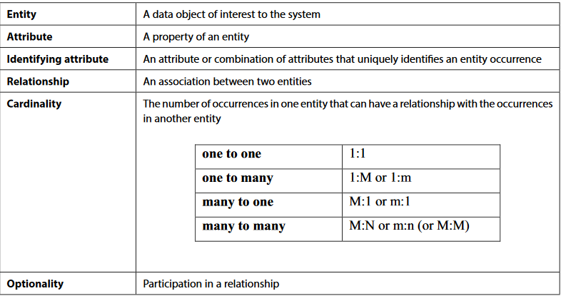
Summary

Slide 42
Logical Database Design
Once you have completed the conceptual design and have produced your Entity Relationship Diagram you can move on to the next stage in the database development lifecycle, namely Logical Design.

Slide 43
Relations
A relation is a logical construct that is similar to a table.
Please note that a relation is not the same as a relationship;
A relational database just stores data, and nothing more, inside tables. Any processing of the data is done by using a data manipulation language which works on the tables to output information or alter values stored within the tables. The most commonly used data manipulation language used for accessing relational databases is the Structured Query Language (SQL);
A relation can be defined as a logical representation of an entity type with its attributes and keys.

Slide 44
example of a relation
CUSTOMER (Customer_no., name, address, date_of_birth, .........)
Customer no. is the unique identifier, but in the relation it is referred to as the Primary Key (PK).
Just as all entity types have a unique identifier, all relations have a Primary Key;

Slide 45
Rules for tables in DB
Consists of columns and rows;
Each row of the table (also called a ‘tuple’
– sounds like ‘couple’) is associated with exactly one
entity occurrence so no two are identical (although column values other than the primary key could be identical)
Rows can be in any order
Each table column contains attribute values

Slide 46
Keys
Keys play a vital role in database design and have to be identified and used correctly. The following terminology is used in association with relational database keys:
a key uniquely identifies an entity occurrence: it is the entity identifier
a primary key is the key ‘chosen’ for a given relation / table
a candidate key is a ‘possible’ primary key (several candidate keys may exist for a relation)
a compound key is a key consisting of two or more attributes

Slide 47
Example for keys
VEHICLE (vehicle_identification_no., registration_no., vehicle_make, vehicle_model, ...)
both vehicle_identification_no. and registration_no are candidate keys.
Which candidate key from the VEHICLE relation above would you choose as the primary key and why?
A manufacturer-assigned vehicle_identification_no. would be chosen, as the vehicle registration_no. may change over
the lifetime of the vehicle. Though depending on the use of the system, vehicle registration no. may be a better choice,
i.e. in a car hire business.

Slide 48
Identifying relations
In order to establish the relationships between entities you will make use of keys. In order to do this a new type of key, the Foreign Key (FK), is needed:
Remember for a 1:M relationship with no optionality at the one end, the primary key from the one end of the relationship goes in at the many end as the foreign key.
A foreign key is an attribute (or combination of attributes) in one relation which exists as a primary key in some other relation.

Slide 49
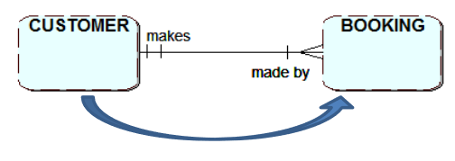
Example of FK
This is the one-to-many relationship between CUSTOMER and BOOKING - conceptual level;
Two relations: CUSTOMER and BOOKING – logical design;
Taking into account the link between these two relations you must copy the primary key of CUSTOMER (which is at the “one-end” of the relationship) into the relation BOOKING (at the “many-end” of the relationship). So the Customer_no. becomes a foreign key in the relation BOOKING.
CUSTOMER (Customer no., customer name, customer_address, ...)
BOOOKING (Booking ref.,Booking_date, Customer_no, ...)
Can you think of a reason why you must put the foreign key into the BOOKING table and not the other way around?

Slide 50
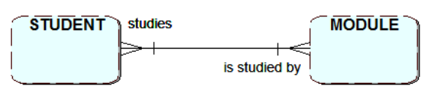

Resolving many-to-many relationships
Note that in the last relation here, which represents the M:N relationship, both foreign keys are needed together to form a compound primary key, which will uniquely identify occurrences that will exist in the resulting relationship table STUDY.

Slide 51
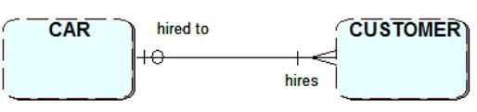
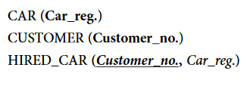
Resolving one-to-many relationships with optionality
A customer may not be allocated a car for hire immediately i.e. when they make a booking;
No car reg. to enter! The value would be what is referred to as null; however it is not acceptable to allow a null value for any key.
The Customer_no. was chosen as the primary key for the new relation as the customer is only allocated one hire car at a time. With this arrangement an entry is only made in the HIRED_CAR table when a car is actually allocated to a customer.

Slide 52
Resolving one-to-one relationships
There are three possible combinations for one-to-one (1:1) relationships and each requires a different process;
1:1 relationship which is mandatory at each end;
1:1 relationship with optionality at one end;
1:1 relationship with optionality at both ends;

Slide 53
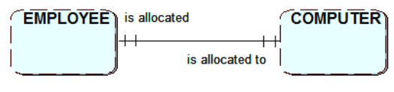

1:1 relationship which is mandatory at each end
At the logical design stage the two entities are effectively merged into one relation with a single primary key. Either of the following skeleton relations could be used:

Slide 54
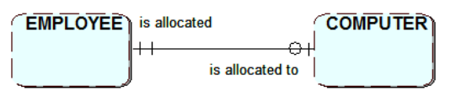

1:1relationship with optionality at one end
The key of the entity at the non-optional end is posted into the relation for the optional entity. This approach avoids ending up with null value Employee_No attribute in the COMPUTER table

Slide 55
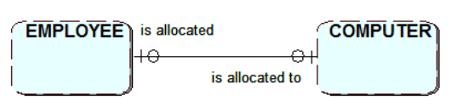
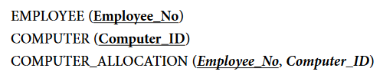
1:1 relationship with optionality at both ends
Three relations are needed, one for each entity and one to express the relationship between the employees and their computers:
Note that eitherof the original identifiers could have been used as the primary key for the third relation.

Slide 56
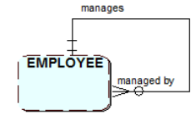
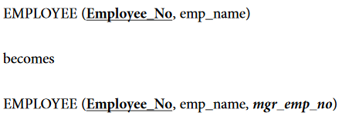
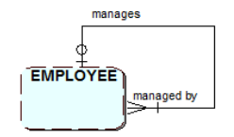
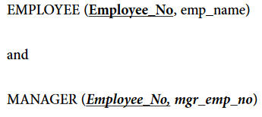
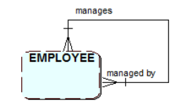
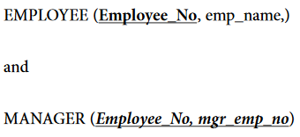
Recursive relationships
When you have an entity type which can have an occurrence that relates to other occurrences of the same entity type this is called a recursive relationship and can be shown as follows:

